Slide 1

Ensemble Learning Based Credit Card Fraud Detection System
Harry Atulah
127135
ICS 4A
Supervisor: Deperias Kerre

Slide 2
Problem Statement
The Internet has grown significantly during the past years. As a result, services like e-commerce, tap-and-pay systems, online bill payment systems, etc. have proliferated and gained in popularity. As a result, credit card fraudsters are now more active than ever in their attacks on transactions.
Hence the need of a strong system to stop these Frauds. Credit cards are like targets for them, and without a good defense, we risk losing a lot of money.

Slide 3

Motivation
The significant impact of Credit Card Fraud on individuals
Rising cyber threats
There is no Credit Card Fraud detection system using Machine Learning in Kenya.

Slide 4
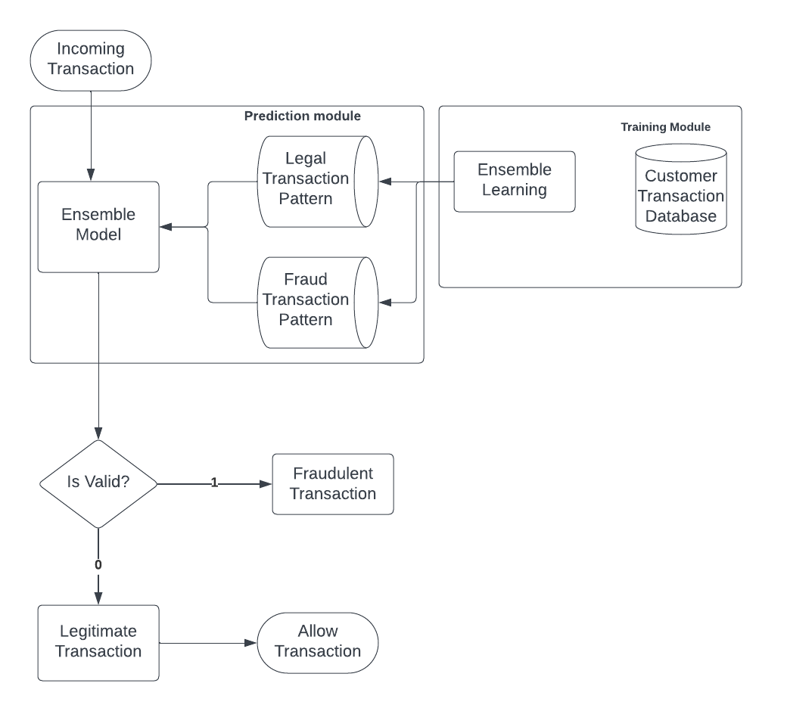
Designed Solution

Slide 5

Solution Demonstration
Upload data- model predicts

